Slide 1
Super Node responsibilities:
Keep track of worker nodes Assign tasks to worker nodes
Validate computation result from worker nodes
Compute reward for tasks
Write to blockchain for transaction data
Super Node
Worker Node
Worker Node
Worker Node
Worker Node
Worker Node
Worker Node responsibilities:
Computes task assigned by super node

Slide 2
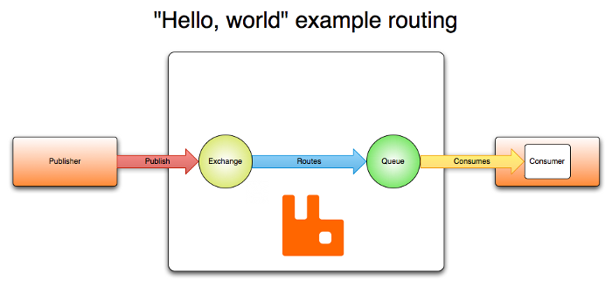
Process
Computer1 sign up to contribute GPU power
Computer1 is given task1 to compute on their machine
Computer1 finishes task1 and its work1 is validated
Once work1 has been validated, Computer1 is rewarded for contributing its GPU
Task distribution framework (RabbitMQ)

Slide 3
Customer
Super Node
RabbitMQ
Worker Node
Ethereum
Submit job
Cut up job into smaller jobs
Queue job into RabbitMQ
Route a job to a worker
Worker node computes the job
Return result back to super node
Feedback job is done
Verify computation result
Compute reward for worker node
Send reward and write transaction data to Ethereum

Slide 4
Use cases
New user signup
User login
Customer issue new task/request
User logout
User register worker
User install docker image
User shutdown docker image, with no active job
User shutdown docker image, with active job (flow is similar to diagram 7)
User startup docker image
Worker receives, completes task
Job verification logic to ensure payout

Slide 5
Assumptions
A customer is the same as a worker. Basically, combine both roles into 1 user account on the website/marketplace
1 user account can have 1-N wallet. To run as a worker node, each worker node is tied to 1 unique wallet. The wallet address becomes the unique key to the worker node’s docker image
Results returned is in json format. Request into order is also json, with list of filepath over the web
Select 1-N files (do not allow to select zip/rar)
Database table design
User_account (username, password, email address, wallet address, online)
Worker_node (wallet address, cpu serial?, mac address?)
Job_order (price, status)
Job (price, status, payment id, acknowledgement id)
File_location (filepath)
User_account is 1:N Worker_node
Worker_node is 1:N Job
User_account is 1:N Job_order
Job_order is 1:N Job
Job_order is 1:N File_location
Job is 1:N File_location

Slide 6
1
User
Web Interface
Server
Database
Access website
Register new user
Fill in information
(username, password, wallet, email address)
Click “register”
Register request
Query user_account to see if username and email address already exist. If does not exist, create new user. If exist, error out
Return info
New user account created, email confirmation sent to email address

Slide 7
2
User
Web Interface
Server
Database
Access website
Login with username and password
Login request
Query user_account to see if username and password combination match, if online, error out.
Update user_account to indicate online
Retrieve info from job_order
Retrieve info from worker_node
Return info
Display homepage, showing summary of job orders, worker nodes

Slide 8
3
User
Web Interface
Server
Database
Click “new job order”
Display job order popup, showing type (image classification), price (in AWO), placeholder to upload images (filter by jpeg/png format, select 1 to many)
Select images
Click “confirm”
Job order request
Query user_account for wallet address
Query wallet to check balance. If insufficient, error out.
Download images from user computer
Done

Slide 9
3 - continued
Ethereum
Server
Database
RabbitMQ
Worker
Transfer tokens from user’s wallet for the job order to server’s own escrow wallet
Create entry in job_order
Create entries in file_location
Split job into smaller jobs
Send jobs to RabbitMQ
Send job with information to worker
Create entry in job
Update entries in file_location

Slide 10
4
User
Web Interface
Server
Database
Access website
Click “logout”
Logout request
Update user_account to indicate offline

Slide 11
5
User
Web Interface
Server
Database
Click “register worker”
Display register worker popup, asking user to fill in wallet information. If no worker has been registered, user can select existing wallet. If user has registered at least 1 worker, user need to fill in new wallet address.
Click “confirm”
Register worker request
Query worker_node to check that wallet address has not been used previously. If so, error out, else create entry
Generate docker for this wallet address
Return download link
Click “download”

Slide 12
6
User
Worker
RabbitMQ
Install docker application
Run docker image
Check to see if there are sufficient resources on computer
Register with rabbitMQ

Slide 13
7
User
Worker
RabbitMQ
Shutdown docker application
Check to see if it is running existing job
Deregister from RabbitMQ

Slide 14
7
User
Worker
RabbitMQ
Shutdown docker application
Check to see if it is running existing job
Deregister from RabbitMQ

Slide 15
9 – similar to diagram 6
User
Worker
Server
Startup docker image
Check to see if there are sufficient resources on computer
Register with RabbitMQ

Slide 16
10
Server
Worker
Essepi Docker
RabbitMQ
Send job information
Parses job information
Download model, and job inputs
Load model
Send inputs
Return response
Parses response
Uploads response to a specified location
Sends completed message

Slide 17
11
Server
Database
Ethereum
Check for job response to verify
Parses job response (should contain result, job id, worker id)
Validate result
Update worker_node entry with job ids
Query worker_node for wallet address
Payout to worker for the job completion
Return transaction id
Update job with transaction id

Slide 18
11 – continued
Server
Database
Ethereum
Check to see if entire job has been completed (? Is the logic?)
Update job_order to indicate completion
Sends email to user to indicate job completion

